Slide 1
Pi Bracket to Mount to Wood

Slide 2
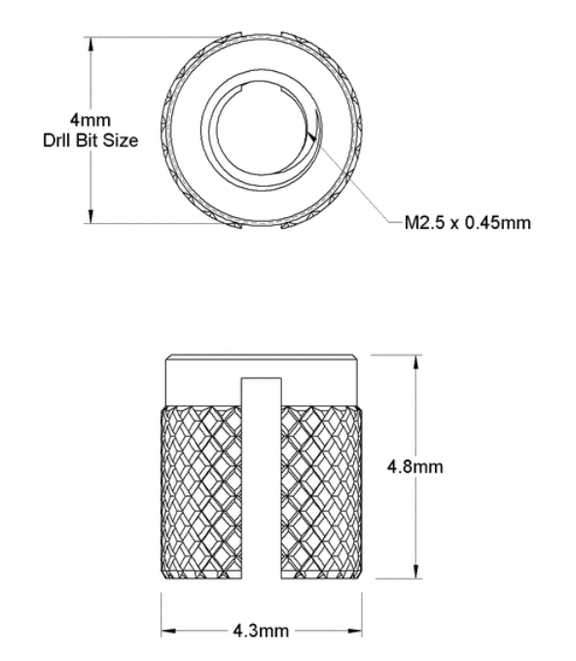
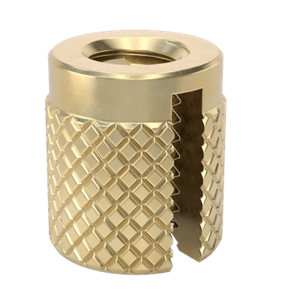
M2.5 Thread Insert
https://www.mcmaster.com/94510A612/

Slide 3
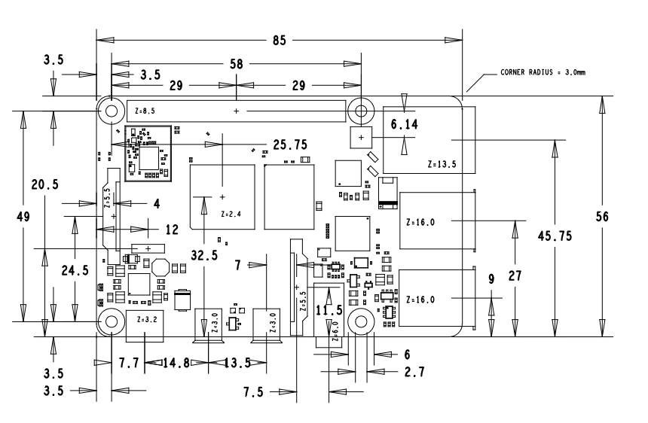
Pi 4 mechanical drawing

Slide 4
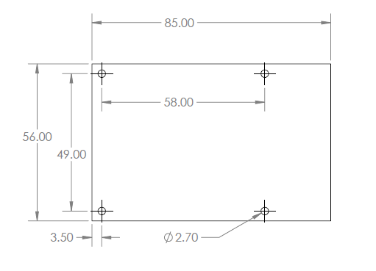
Simplified Pi 4 holes and board dimensions

Slide 5
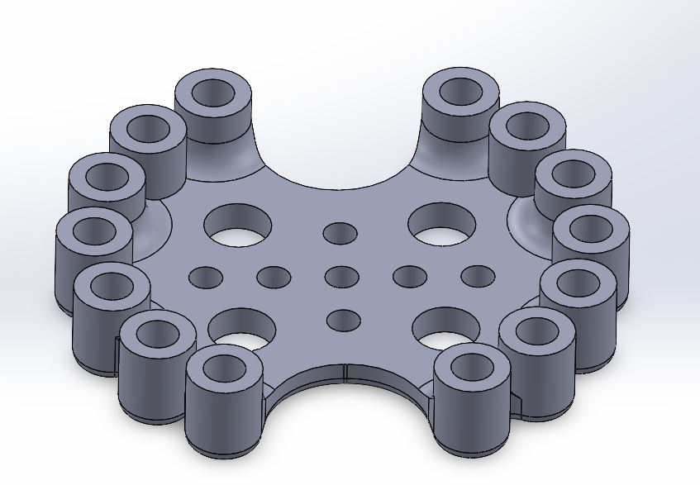
Bracket to mount Circuit Playground Express

Slide 6
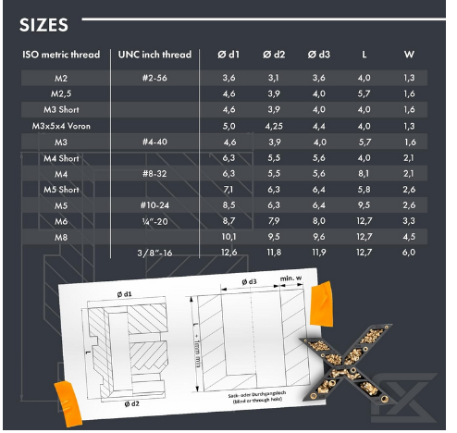
Thread inserts for 4-40 for Circuit Playground Express
4-40 inserts L is 5.7 mm, or 5.7 on 3 mm for a total height of 8.7 mm, d3 + 2xw = 4+3.2=7.2mm
https://www.amazon.com/ruthex-4-40-Threaded-Inserts-RX-4-40x5-7/dp/B0CG4M8HC5/

